Slide 1


HEART DIESEASE PREDICTION
Project Presentation By
Nikhilraj Rindhe
Gourang Baviskar
Akshay Shirsath
Minal Patil
Under Guidance of
Mr.Kushal Sharma

Slide 2

HEART DIESEASE

Slide 3

PROBLEM STATEMENT
To predict the possibility of having heart disease ?

Slide 4
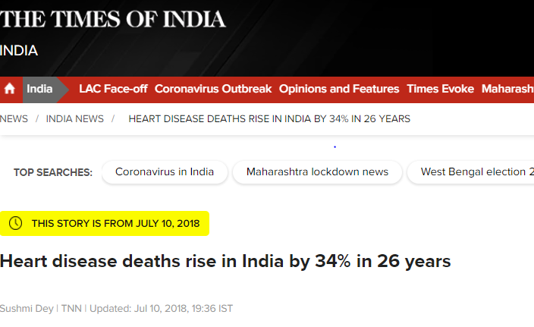
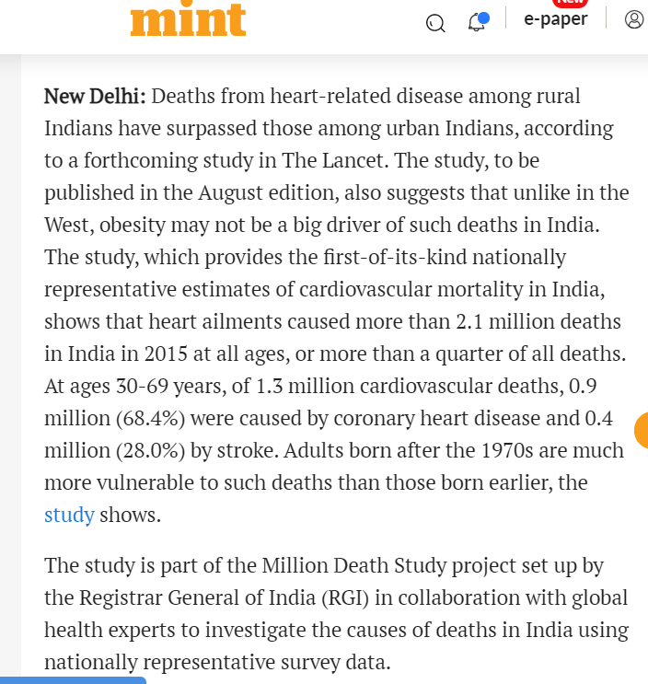
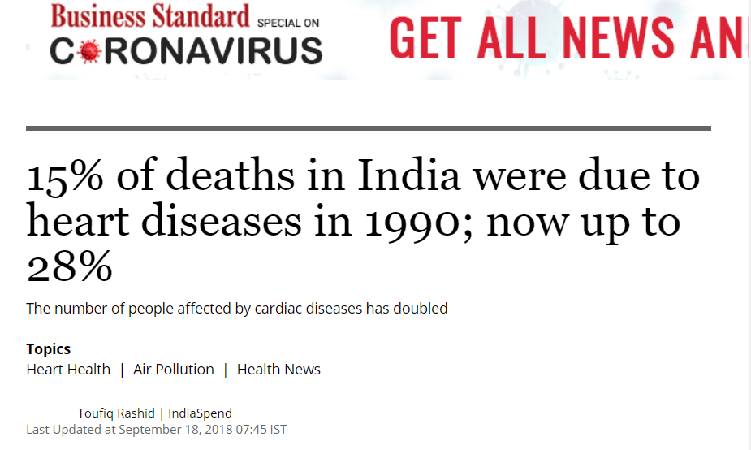

Slide 5

EXISTING SCENARIOS

Slide 6

PROPOSED SOLUTION

Slide 7


Slide 8
CHALLENGES
Improving quality of analytical data
Using data to improve experiences

Slide 9
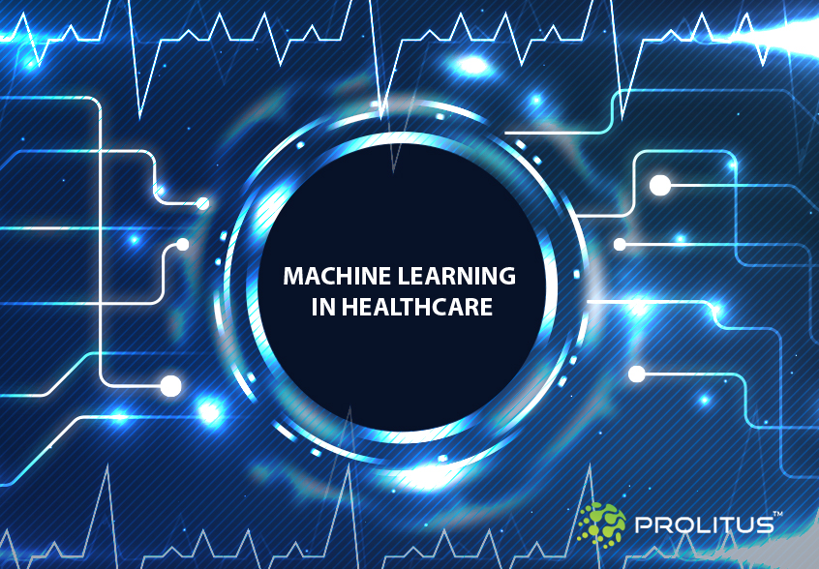
BENIFITS
1. Diseases identification and Diagnosis
2. Medical Imaging
3. Drug Discovering and Manufacturing
4. Smart Health Record
5. Diseases Prediction

Slide 10
ARCHITECTURE DIAGRAM
Data
Analysis
(Machine learning)
Data Sources
Hadoop
Reporting
(Patient Report)
(Data Warehouse)
(Tableau)

